Slide 1
[Paper Overview] Multiple Context Features in Siamese Networks for Visual Object Tracking Henrique Morimitsu University of Grenoble Alpes, France
Published in the workshop of Europian Conference on Computer Vision (ECCV) - 2018
Presented by:
Md. Maklachur Rahman School of Computer Science and Engineering
Kyungpook National University
Republic of Korea

Slide 2
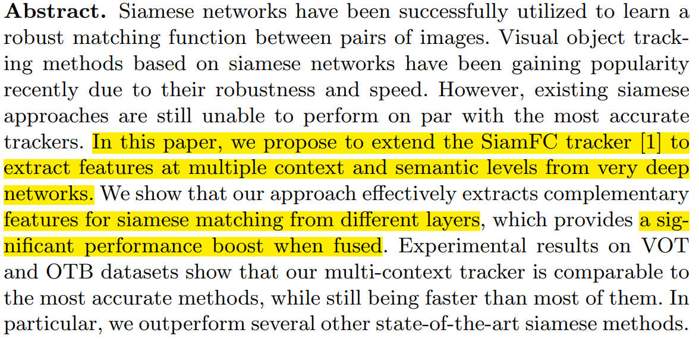
Abstract
In this paper, they introduce very deep network called Resnet-50 rather than shallow AlexNet to extract the features.
They compute more cross correlation layer instead of one in the last layer which gives the significant boost to the performance.
This tracker outperforms several other state-of-the-art Siamese based tracker in terms of accuracy and speed on VOT and OTB benchmark dataset.

Slide 3
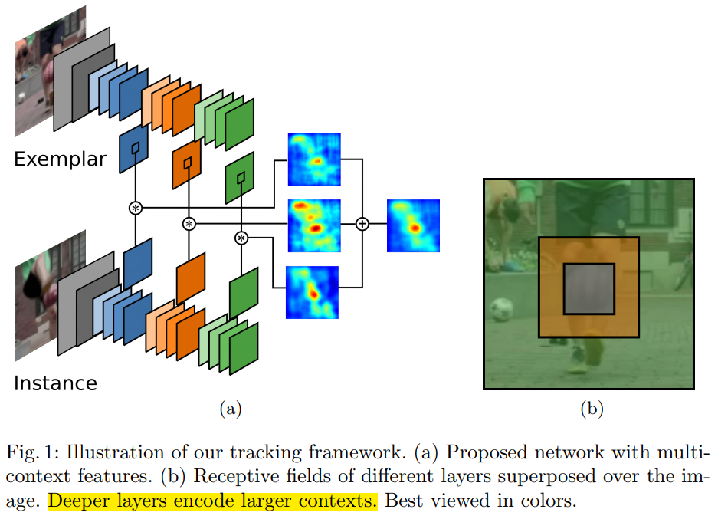
Tracker architecture
Only Multi-layer features can provide different global representations for the same image.
Multi-context features, filters from different layers can be more diverse, focusing on different regions of the image.
They use central feature cropping when they compute correlation score.

Slide 4
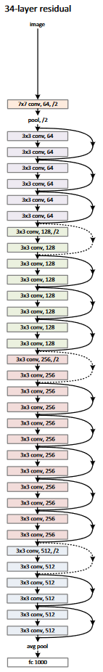
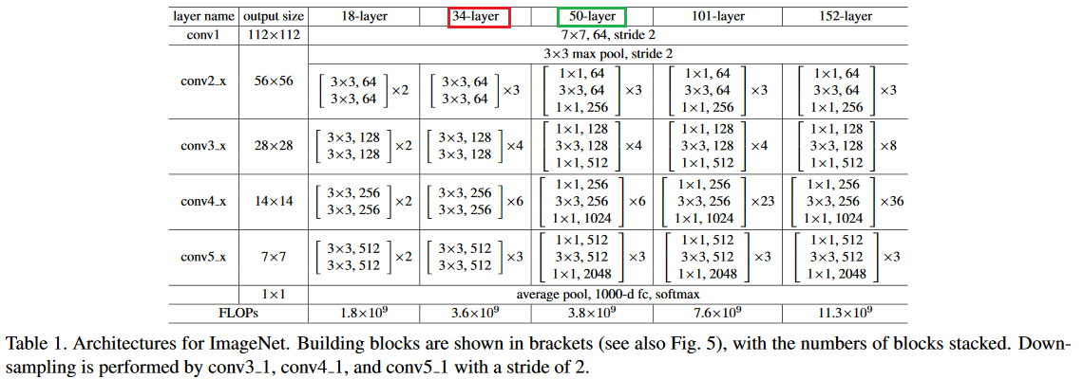
Basic Resnet architecture
N.B. These two images are taken from the original Resnet paper.

Slide 5
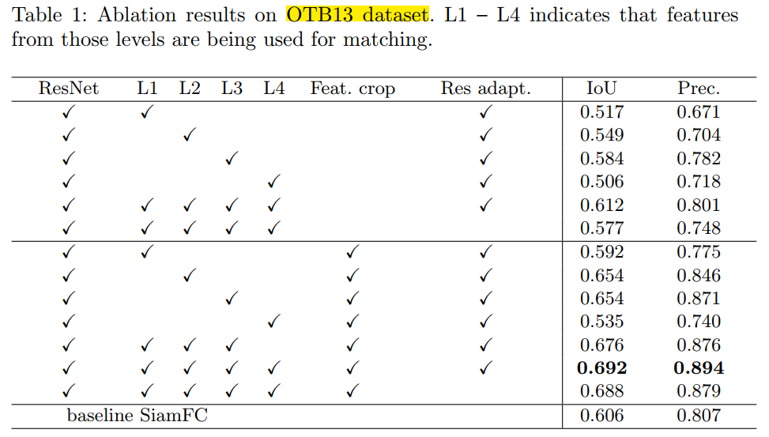
Ablation results on OTB13 dataset

Slide 6
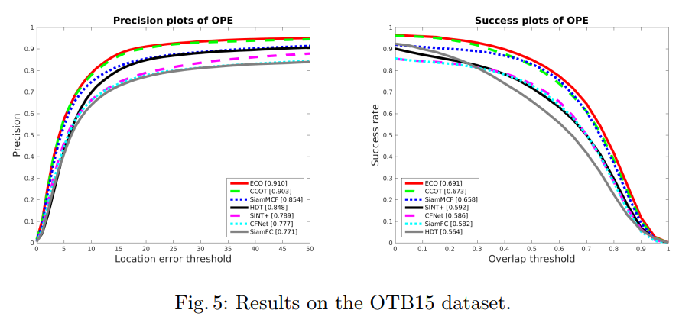
Experimental results of OTB 2015

Slide 7
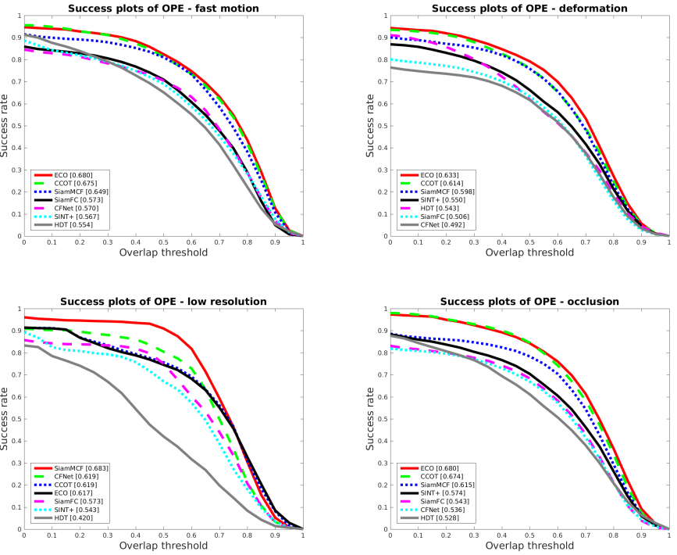
Experimental results on different challenges
Figure 6: OTB15 success plots for different attributes.

Slide 8
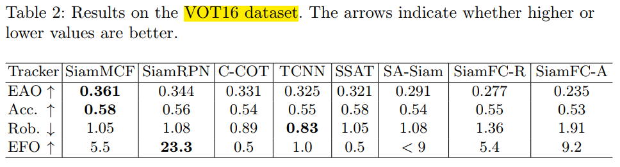
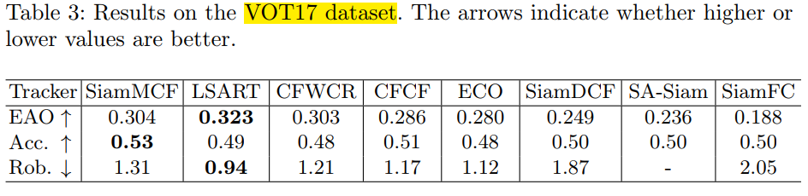
Experimental results on VOT dataset

Slide 9
Conclusion
They shows the importance of each layer contribution for calculating a good score map.
Incorporating a deep neural network in the Siamese tracker able to obtain better results than shallow network.
Even though they use of multi-context features and deep networks, their tracker remains faster than many of the top-performing methods, running at almost real-time speeds.

Slide 10
감사합니다 (Thank you) Q&A

